Slide 1
Skilled Technical Workforce Pathways
Data Science for the Public Good, Summer 2019
Vicki Lancaster, Ph.D., Alyssa Fowers, Sarah McDonald, and Calvin Isch

Slide 2
Research Questions
What are the pathways to a non-degree credential for individuals with an Associate’s degree or less in Virginia that will provide them with the skills necessary to secure a job in the skilled technical workforce (STW)?
Can we develop a metric that will identify the weak points in the pathway that can be useful for job seekers, policy makers, and educators?
Can this proof of concept be extended to other states?

Slide 3
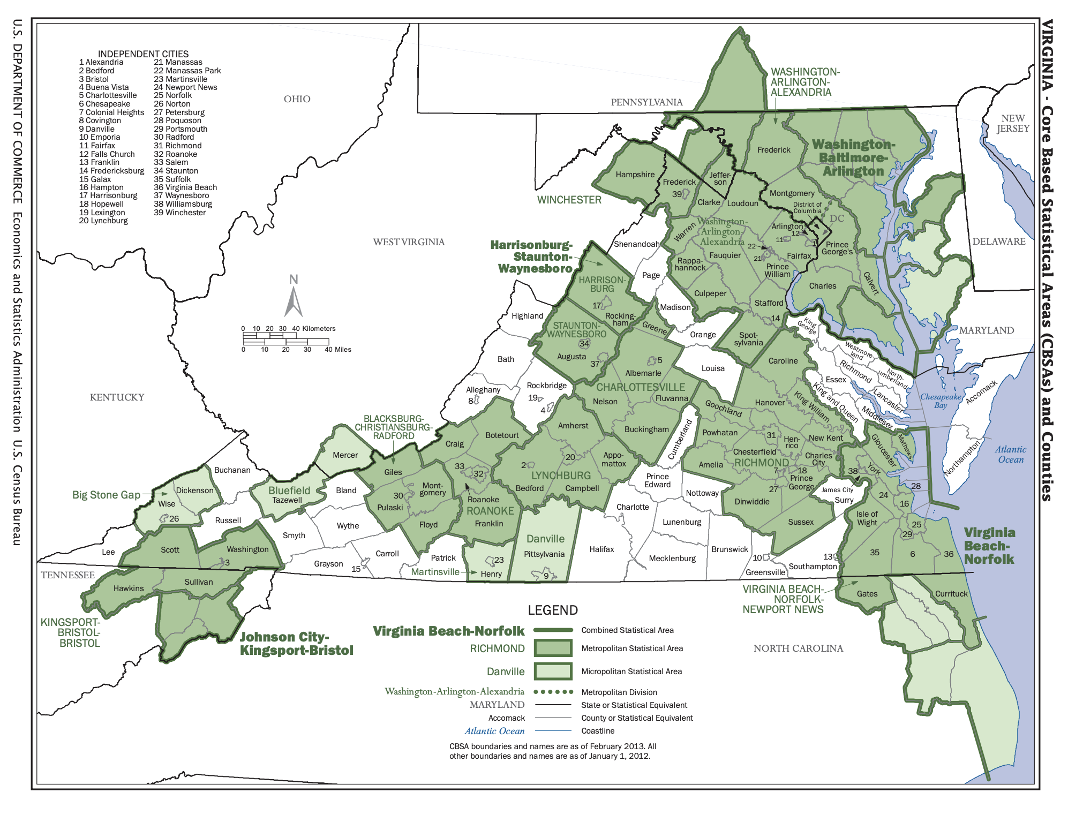
Our Proposal…
As a proof of concept:
we will look at at least two metropolitan statistical areas (MSAs) in Virginia for the year 2017;
the two MSAs we are considering are Richmond and Blacksburg.

Slide 4
Data Pathways
Which jobs qualify as skilled technical work?
What skills are
required for local STW positions?
What skills do employers need?
Skilled Technical Worker definition (Rothwell)
Job Ads
(Burning Glass)
O*NET codes
Do local educational opportunities match the local job market?
What skills are missing from the workforce?
BGT skills classifications
?
?
Are there opportunities to gain missing skills and credentials?
Educational Opportunities
Resumes
(Burning Glass)
What skills do job seekers already have?
How can job seekers gain new skills and credentials?

Slide 5

Burning Glass Technologies* (BGT) delivers job market analytics that empowers employers, workers, and educators to make labor market data-driven decisions.¹
BGT collects job postings from close to 50,000 online job boards, newspapers, and employer sites on a daily basis. Artificial intelligence is used to de-duplicate job advertisements and extract more than 70 variables per advertisement to create the repository of jobs data. Data has been extracted since 2007 with the exception of 2008 and 2009.
* https://www.burning-glass.com/about/

Slide 6
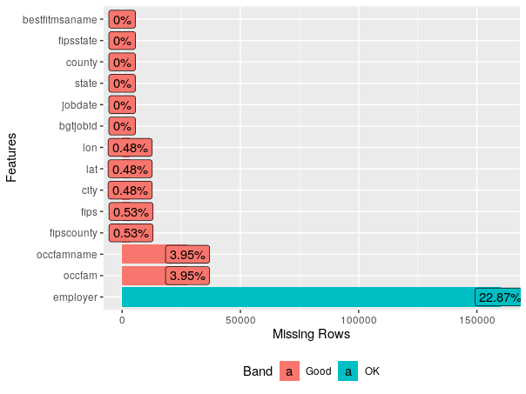
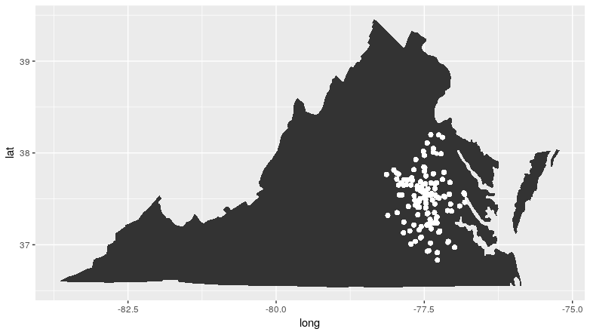
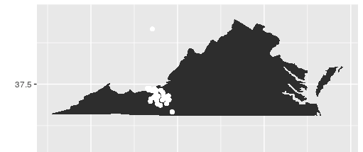
Job Ad Data Description
Job-ad Data
5 data files: main, skills, major, classification of instructional program codes, & certifications
699,754 unique job postings in Virginia in 2017
Example of Data Profiling for Completeness
99,997 unique postings for Richmond MSA
11,232 unique postings for Blacksburg MSA

Slide 7
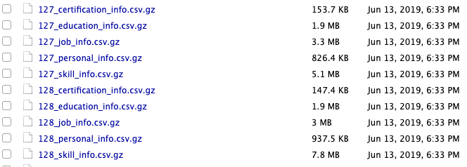
Resume Data Description
We have been unable to locate any research publications (other than those authored by BGT) that have used or validated the resume data. The resume dataset is a BGT proprietary dataset, sourced from Burning Glass partners. This dataset includes information about an individual’s demographics, career path, education, certifications, skills, and employers.
Unlike the job-ad data, the resume data contains over 2,200 files, with no clear naming conventions that would provide us with clues on how to link them.

Slide 8
Education Data - Providers of Traditional Credentials
National Center for Education Statistics (NCES)
  Career and Technical Education (CTE) Statistics
Virginia Department of Education (VDOE)
  Career & Technical Education (CTE) Program Graduates and Completers
State Council of Higher Education for Virginia (SCHEV)

Slide 9

Education Data - Providers of Alternative Credentials
CareerOneStop
  Certification
  Licenses
  Professional Associations
  Apprenticeship

Slide 10

Education Data - Providers of Alternative Credentials
Credential Engine Registry
  Apprenticeship Certificate
  Associate Degree
  Bachelor Degree
  Badge
  Certificate
  Degree
  Digital Badge
  Diploma
  Doctoral Degree
  General Education Development
  Journeyman Certificate
  Licenses
  Master Certificate
  Master Degree
  MicroCredential
  OpenBadge
  Professional Doctorate
  Quality Assurance Credential
  Research Doctorate
  Secondary School Diploma

Slide 11



Education Data - Providers of Alternative Credentials
Class Central
  Massive Online Open Courses (MOOCs)
Course Report & Switchup
  Coding Bootcamps

Slide 12
Measuring Mismatch
Mismatch metric from Berkes, Mohnen, and Taska (2018):
  Employer's perspective: are there enough workers with the right skills to fill open jobs?
  Job-seeker's perspective: are there enough jobs that match skillset of local workers?
Education: Mutual Information Index to get linkage strength between careers and educational paths, compare to local educational opportunities

Slide 13
Considerations and Challenges
Skilled Technical Workforce designation using SOC codes: checking definitions
Should we classify skills and credentials as STW and move away from occupations
Consolidating resume data

Slide 14
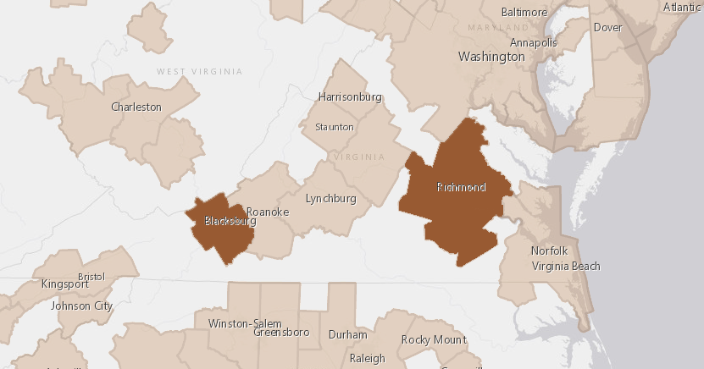
Progress and Plans
Data discovery
Data profiling
Construction of metric to capture mismatch
Exploratory data analysis
Analysis of pathways to STW credentials and mismatch in Virginia

